Slide 1
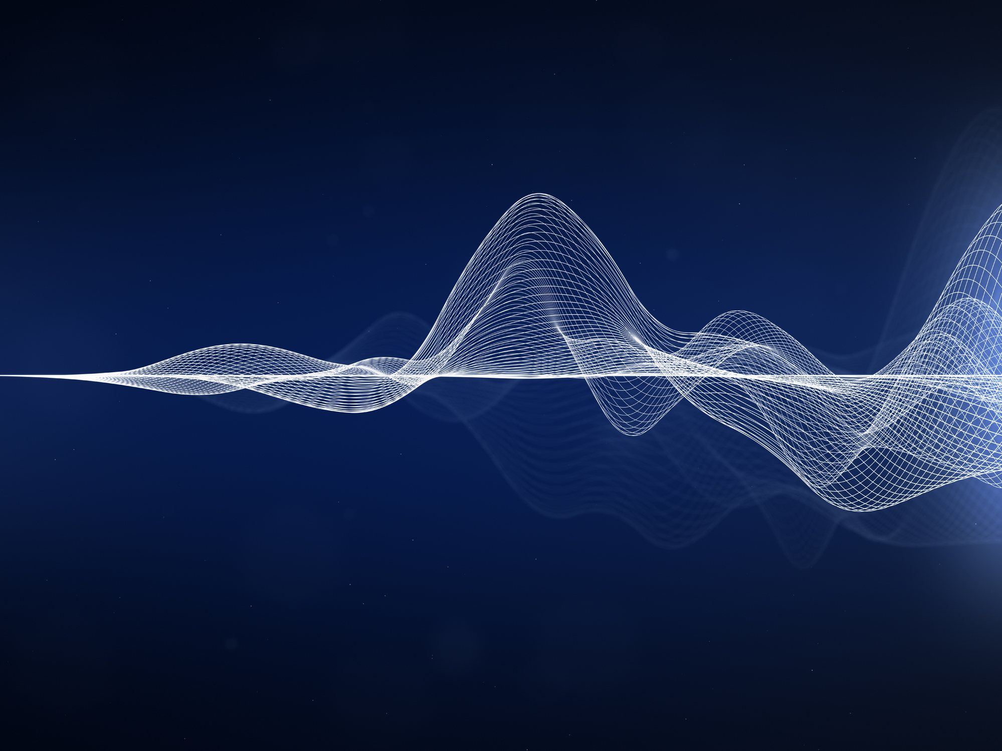
Generating Ambient Music From Raw Audio Using Neural Networks
Timothy Meehan
9/19/19

Slide 2
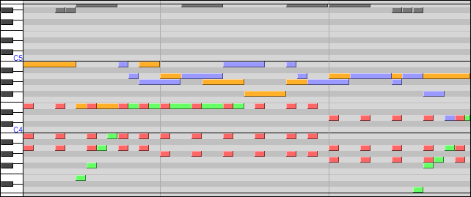
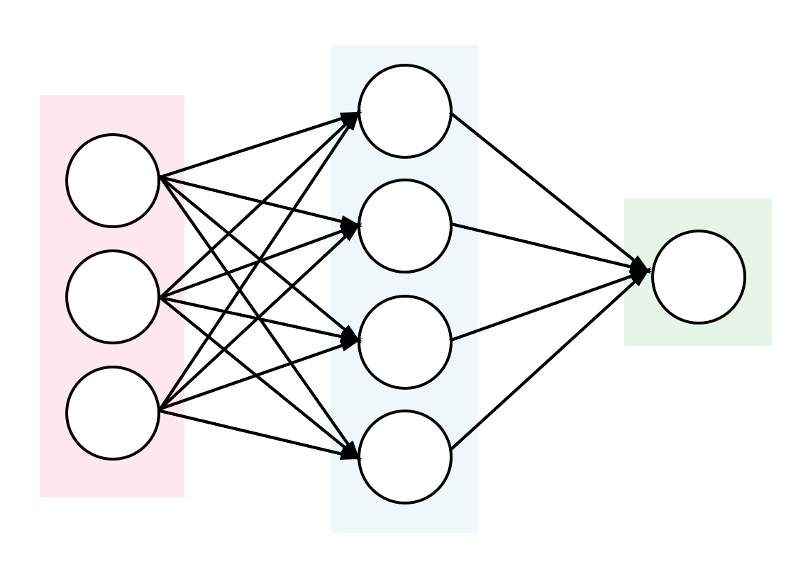
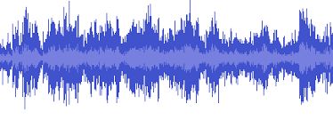
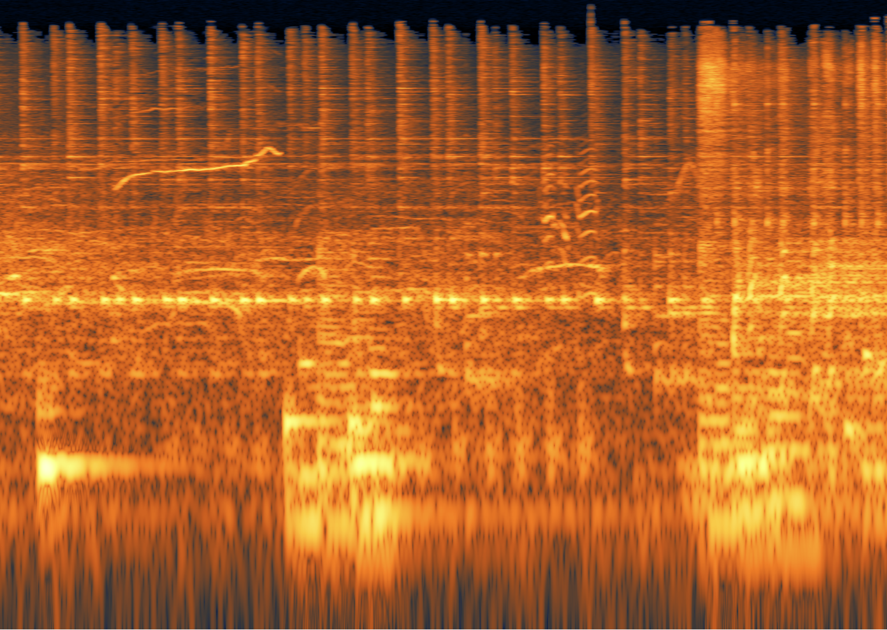
Representational Approach to Machine-Generated Music
Generation Algorithm
Audio
Or
Novel
Representation
Limitations
Captures timbre and dynamics poorly
Degrades audio quality
Notes:
For the most part, machine-generated music is produced not from actual audio but rather some representation such as MIDI sequences or spectrograms. But, the major limitation with this approach is that it either won’t capture certain features like timbre or dynamics, or will produce low quality audio

Slide 3


Project Objectives
Use raw audio with SampleRNN to generate music of high quality
Retain sonic elements of source material while creating novelty
Why ambient music? Music soup might sound good!
Notes:
My objective for this project was to use a recurrent neural network called SampleRNN, which was recently developed to work specifically with raw audio, and thereby retain all those hard-to-represent qualities.
And I wanted to create ambient music because, first of all I listen to it a lot, but also this approach has been demonstrated to produce what you might call ‘music soup’. Here’s an example of that, so this is some output from SampleRNN after it was trained on a Beatles album.
As you can hear, it has a hard time producing something well-structured. So ambient music is ideal because it's pretty unstructured by nature, and so music soup might actually sound good, and hopefully even beautiful

Slide 4
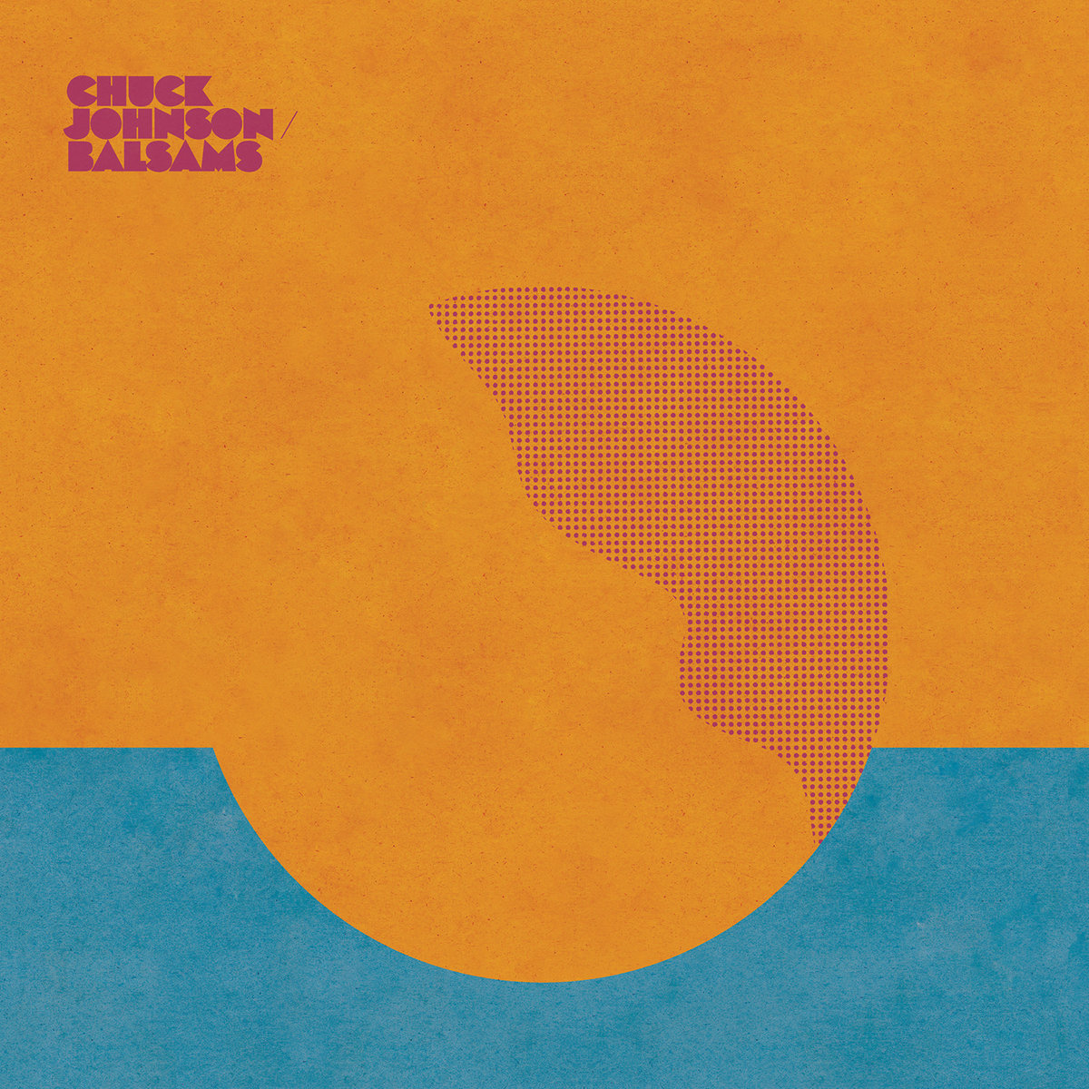
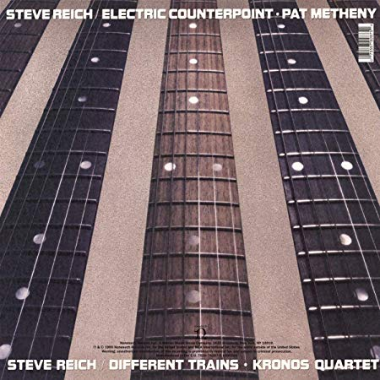

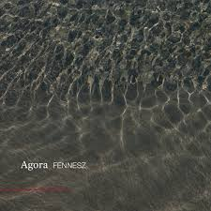

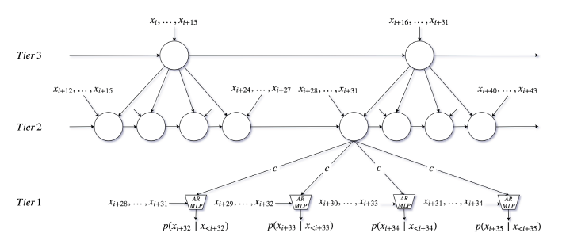





The Process
Get Albums
Preprocess
Generate + Curate
SampleRNN
n=~3000per album
1 new clip per epoch
16 KHz
8 seconds w/ overlap
15-20s
Notes:
For my process, I pulled selected ambient albums from YouTube and converted them to WAV format with a 16 KHz sampling rate.
I then used the PyDub library to cut the albums into 8 second long, overlapping chunks, with about 3000 chunks per album as my training data.
I then trained SampleRNN on individual albums, and as training progressed, I generated new audio at the end of each epoch, and curated the best results

Slide 5
The SampleRNN Model
Predicts next sample conditional on information from multiple timescales
Large Time
Window
(Modules=RNNs)
Timescale
(Long to Short)
Smaller Time
Window
(Modules=RNNs)
Individual
Sample
Generation
(Modules=MLPs)
Time (NewSample1, NewSample2, etc…)
Notes:
Before we listen to some results, how does SampleRNN actually generate new audio?
Well, digital audio is essentially just a sequence of samples, so SampleRNN takes these sequences and generates new ones by predicting one new sample at time conditional on past samples, with the key wrinkle being that each prediction incorporates information from multiple timescales, and this is what helps to capture the inherent structure of music.
In a little more detail, it consists of multiple recurrent neural networks arranged into tiers, which operate on progressively smaller time windows as you move down the hierarchy, and finally at the lowest tier, multi-layer perceptrons operate on the smallest timescale and they incorporate the multi-timescale information into individual sample predictions
So in this fashion, new audio is generated, one sample at a time.

Slide 6
Results

Slide 7
Experiment 1: Balsams by Chuck Johnson
SampleRNN Output
Notes:
So, I’ll play two examples for you from two albums, the first is called Balsams by the artist Chuck Johnson, which sounds like this.
And here’s an example of what the model generated from this album.
So, this is pretty abstract, and I imagine there aren’t a lot of hardcore ambient fans in the room, but I hope you at least agree that the model output captures the character of the original really quite well and even though there is some artifact, it is pretty high quality audio. And it is novel, but it's pretty similar to the original...

Slide 8
Experiment 2: Electric Counterpoint by Steve Reich
SampleRNN Output
Notes:
So in the interest of generating something a little more dynamic I chose this album Electric Counterpoint by Steve Reich, which is a minimalist composition with multiple sections and a lot more temporal variation. Here's an example
And I'll conclude here with the model output, but just to give my opinion, I thought this was much more interesting, it generated something really new and unexpected -- I think there's a certain beauty to it.
And overall, in doing this project I really came to believe that SampleRNN has a lot of potential for machine-generated music in the future, so I'll leave you with this.

Slide 9
Thank you for listening!
Tim Meehan
timeehan@gmail.com
in/tim-meehan

Slide 10
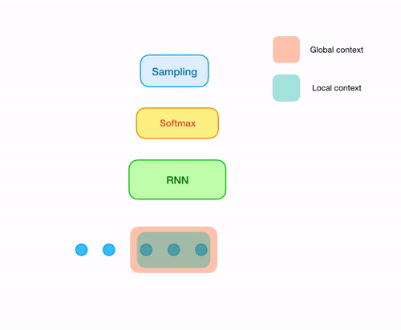
Conclusions

